Slide 1
Linear ALGEBRA
SUBTITLE: Eigenvalues and Eigenvectors

Slide 2
Consider a square matrix , if we take any nonzero vector
Multiplying A matrix with that nonzero matrix will gives another vector, here, we are interested to know what happens for our vector after multiplying by that matrix.
For example, Take , two non zero vectors , .
Then, and .
Here, has of no interest because the vector after multiplication with A, we got totally new vector when compared with original vector .
But, in case of something interesting happens that is
=10.
Here, the new vector is in the same direction as with scale constant

Slide 3
Eigen Value Problem:
Let be any non zero square matrix. Then, finding nonzero vector and a scalar such that it satisfies the equation is called eigen value problem.
Here, is called eigen value and is called eigen vector.
Observation:
Now, consider the equation
( is the identity matrix)
(1)

Slide 4
Procedure to find Eigen value and Eigen vector:
Finding eigen value and eigen vector now reduced to find solution for equation (1)
If we observe which is a homogeneous system of equation
Eigen vector exists if the above system has non zero solution
To know when does the above system has non zero solution, we have to recall Cramer’s rule.

Slide 5
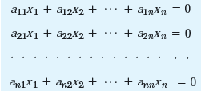
Cramer’s Rule:
Consider the homogeneous system of equation
The above homogeneous has only zero solution if
If, then the above system has non zero solution.
Here,

Slide 6
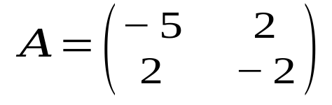
Apply Cramer’s rule for equation , we get non zero vector if
We call, as a characteristic determinant or characteristic polynomial.
Also, is called as characteristic equation.
Example:1 (Determination of Eigen value and Eigen vectors)
Find Eigen values and Eigen vectors of
We are going to illustrate step by step for the above matrix.

Slide 7
Solution:
First, we need to find Eigen value for that consider,
Corresponding system is
Transferring the terms on the right to the left, we get
(2)

Slide 8
The corresponding matrix form is
By Cramer’s rule, the above equation has nonzero solution if
(3)
The solution to equation (3) are .
Here, are called as Eigen values of given matrix A.

Slide 9
Eigen Vector corresponding to Eigen Vector
Consider equation (2), sub ,
We get,
Solution set for the above system is
Choosing one solution from the above solution set , we get .
Here, is called Eigen vector corresponding to Eigen
value .

Slide 10
Eigen Vector corresponding to Eigen Vector
Consider equation (2), sub ,
We get,
Solution set for the above system is
Choosing one solution from the above solution set, we get .
Here, is called Eigen vector corresponding to Eigen
value .

